Slide 1
IBM Data Science Capstone Project Opening a New Shopping Mall in Amsterdam
By: Dinesh Kandimalla
Feb 2020

Slide 2
Business Problem
Objective: The main objective of this project is to find the best location in city of Amsterdam to open a new Shopping Mall.
Location is very important factor to open a new shopping mall.
This project is best helpful for the developers who are looking to open new shopping mall in city of Amsterdam as the city lacks more shopping malls.

Slide 3
Data
Data required
Neighborhoods in city of Amsterdam
Latitude and Longitude of each neighborhood
Venue data in each neighborhood , especially data related to shopping malls.
Data Source
Data related to neighborhoods is available in kaggle datasets.
https://www.kaggle.com/dushyantsapre/amsterdam-neighbourhood-and- venues
Foursquare API is used for getting venue details.

Slide 4
Methodology
Get neighborhood details in the city.
Use Foursquare API to get details about venues.
Group data by neighborhood and calculate the mean frequency of occurrence of each category in venue.
Filter this grouped data by venue category as shopping mall.
Cluster this grouped data of shopping mall by k-means clustering.
Visualize the clusters on map with folium library.

Slide 5
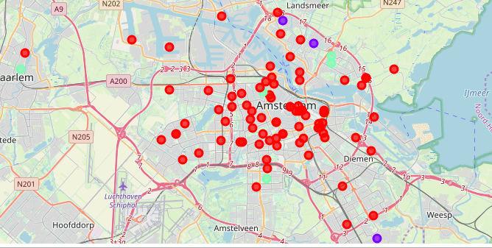
Results
Neighborhoods are classified into 3 clusters.
Cluster 0 : Neighborhoods
with less number of shopping malls.
Cluster 1 : Neighborhoods
moderate number of shopping malls.
Cluster 2 : Neighborhoods with
high number of shopping malls.

Slide 6
Discussion
Most of the shopping malls are concentrated in cluster 2 and moderate number in cluster 1.
Cluster 1 has very less number of shopping malls.
Oversupply of shopping malls are in cluster 2. So it is not at all recommended to open shopping mall in cluster 2.

Slide 7
Recommendation
From the results and discussion , it is recommended to open shopping malls in cluster 0 with no competition.
Can also open shopping malls in cluster 1 with moderate competition.
It is recommended to avoid opening new shopping malls in cluster 2.

Slide 8
Thank You

